Slide 1
Naïve Bayes
Will Stearns, Sharif Rakhimov, Phil Carbino, Derek Preslar

Slide 2
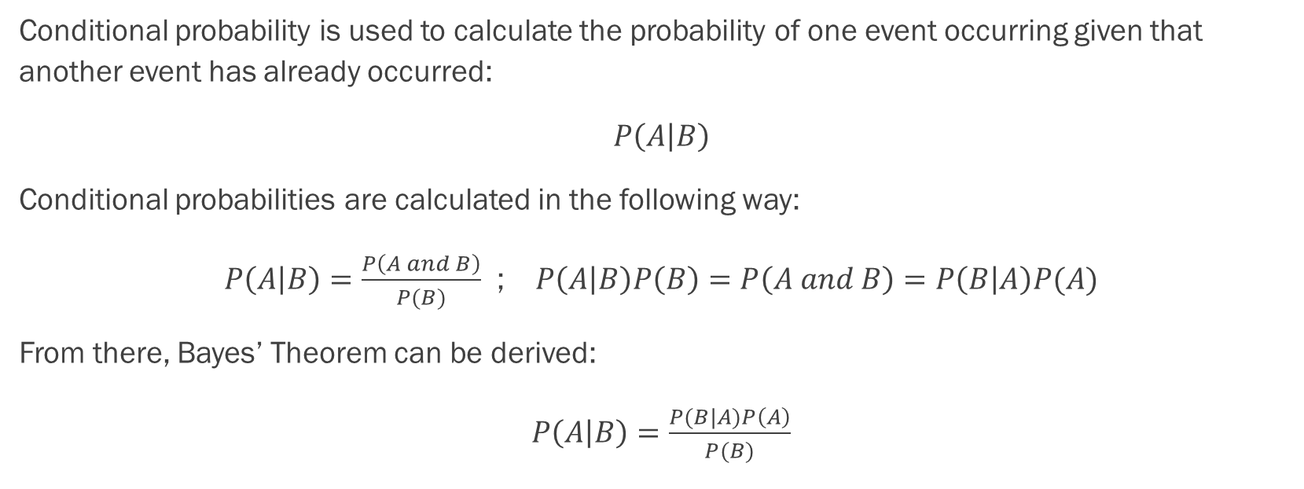
Naïve Bayes: Conditional Probability Basics
Conditional probability is used to calculate the probability of one event occurring given that another event has already occurred:
$P\left(A | B\right)$
Conditional probabilities are calculated in the following way:
$P\left(A | B\right)=\frac{P\left(A and B\right)}{P(B)}$ ; $P\left(A | B\right)P\left(B\right)=P\left(A and B\right)=P\left(B | A\right)P(A)$
From there, Bayes’ Theorem can be derived:
$P\left(A | B\right)=\frac{P(B|A)P\left(A\right)}{P(B)}$

Slide 3
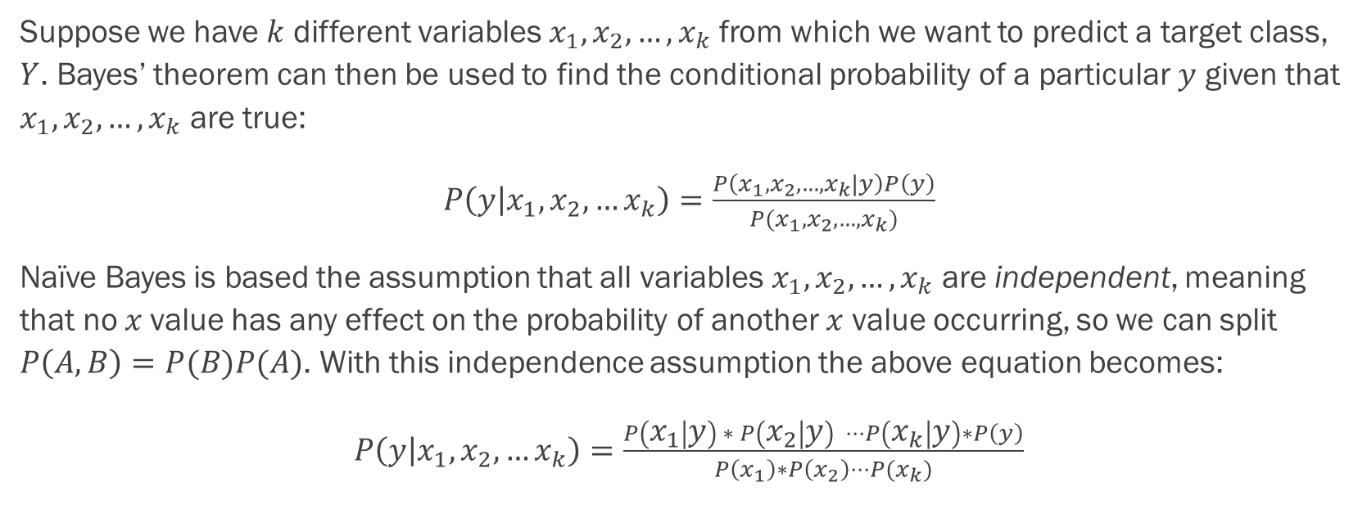
Naïve Bayes: The Central Assumption
Suppose we have $k$ different variables $x_{1}, x_{2}, …, x_{k}$ from which we want to predict a target class, $Y$. Bayes’ theorem can then be used to find the conditional probability of a particular $y$ given that $x_{1}, x_{2}, …, x_{k}$ are true:
$P\left(y | x_{1},x_{2},…x_{k}\right)=\frac{P\left(x_{1},x_{2},…,x_{k}|y\right)P\left(y\right)}{P(x_{1},x_{2},…,x_{k})}$
Naïve Bayes is based the assumption that all variables $x_{1},x_{2},…,x_{k}$ are independent, meaning that no $x$value has any effect on the probability of another $x$ value occurring, so we can split $P\left(A, B\right)=P(B)P(A)$. With this independence assumption the above equation becomes:
$P\left(y | x_{1},x_{2},…x_{k}\right)=\frac{P\left(x_{1} | y\right) ∗ P\left(x_{2} | y\right) ⋅⋅⋅P\left(x_{k} | y\right)∗P\left(y\right)}{P\left(x_{1}\right)∗P\left(x_{2}\right)⋅⋅⋅P(x_{k})}$

Slide 4
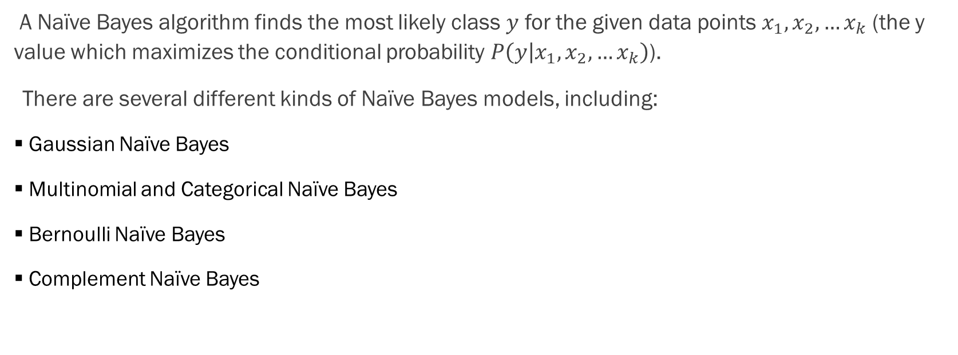
Naïve Bayes
A Naïve Bayes algorithm finds the most likely class $y$ for the given data points $x_{1},x_{2},…x_{k}$ (the y value which maximizes the conditional probability $P\left(y | x_{1},x_{2},…x_{k}\right)$).
There are several different kinds of Naïve Bayes models, including:
Gaussian Naïve Bayes
Multinomial and Categorical Naïve Bayes
Bernoulli Naïve Bayes
Complement Naïve Bayes

Slide 5
Advantages:
Simple to implement
Fast and effective in predicting the class of datasets
Doesn’t require a large test set to work well
Can handle both discrete and continuous data
Useful for text analysis and classification problems
Can be used for multiple class prediction problems

Slide 6
Disadvantages:
Relies upon the assumption that variables are independent
Not ideal for data sets with a large number of variables
Zero Frequency Problem

Slide 7
Data Processing Steps
Convert categorical features to numeric (get dummies)
Handle missing data. Drop or impute
Identify outliers, remove or convert into numbers
Separate dependent feature from independent features
Gaussian- continuous data, need to be distributed normally
Data smoothing- so that no probabilities are completely zero

Slide 8
Most Adjusted Hyperparameters
Gaussian Naïve Bayes
var_smoothing
Bernoulli Naïve Bayes
alpha
fit_prior
binarize
Multinomial and Categorical Naïve Bayes
alpha
fit_prior
Complement Naïve Bayes
alpha
fit_prior
norm

